Slide 1
CSE WORKSHOP:
INTRO TO WEB DEVELOPMENT
Speakers: Divija Akham, Shreya Thakur
Event Managers: Roshini Konjeti, Gautam Arora

Slide 2
Agenda
Introduction and Setup
What is Web Development and its frameworks
Evolution
Front-End vs Back-End vs Full-Stack
HTML Fundamentals
CSS Fundamentals
Bootstrap
JavaScript Basics
Combining HTML, CSS, and JS for creating portfolio

Slide 3

Setup
Code Editor (VSCode): Installed and set up.
Browser: Google Chrome, Firefox, or Safari.
Git: Version control tool (especially useful for projects with teams).

Slide 4
What is Web Development

Slide 5
Introduction
Web Development is the process of creating websites or web applications that run in a browser.
It involves designing, building, and maintaining websites using a combination of frontend and backend technologies.
Divided into three main categories:
Frontend Development
Backend Development
Full-Stack Development
Common tools and frameworks include:
Frontend: React, Angular, Vue
Backend: Express.js, Django, Flask

Slide 6
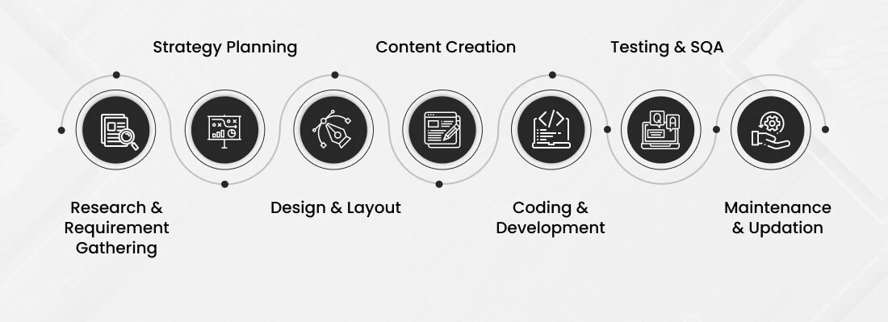
Stages of Web Development

Slide 7
Evolution

Slide 8
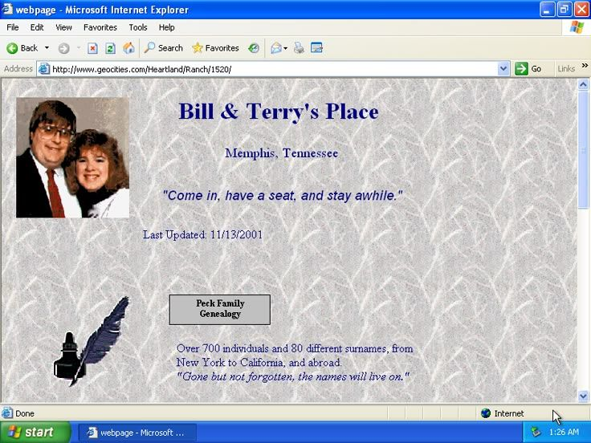
1. Web 1.0 (Early 1990s - 2000)
Static websites (HTML, CSS)
Read-only content
No interactivity or user login

Slide 9
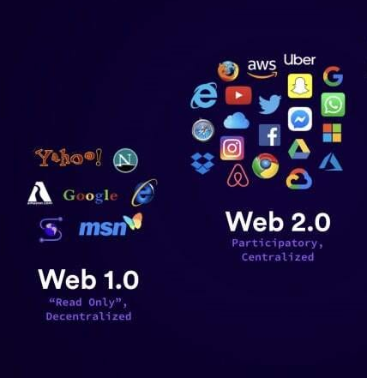

2. Web 2.0 (2000 - 2010s)
Dynamic and interactive websites
JavaScript, PHP, AJAX, MySQL
User-generated content, blogs, forums
Social media platforms emerged

Slide 10
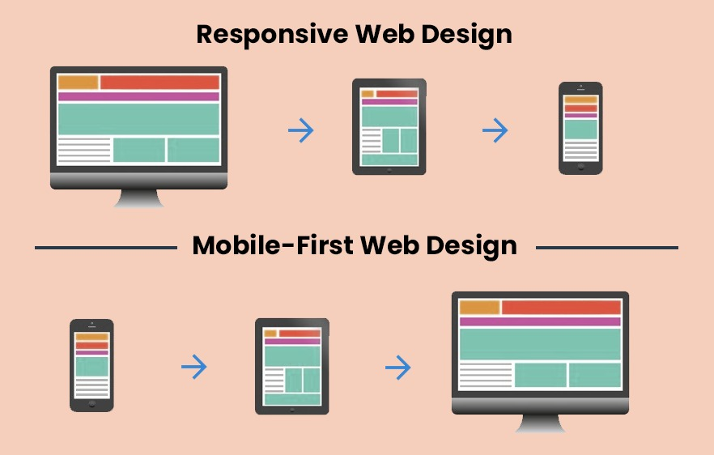
3. Mobile-First & Responsive Design (2010s)
Websites adapt to screen sizes
HTML5, CSS3, media queries
Rise of mobile apps and PWA (Progressive Web Apps)

Slide 11
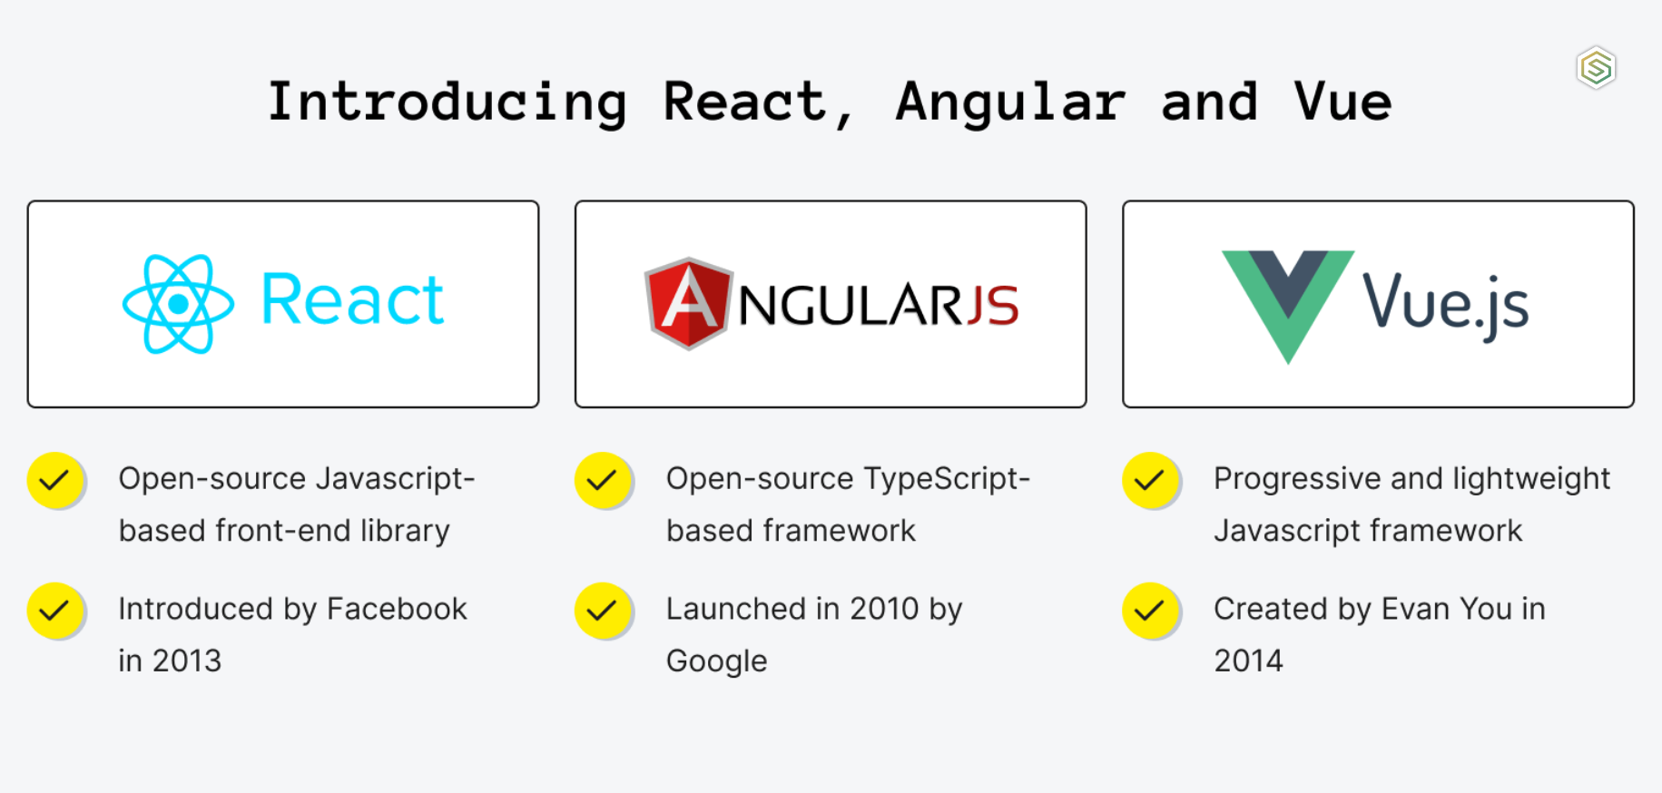
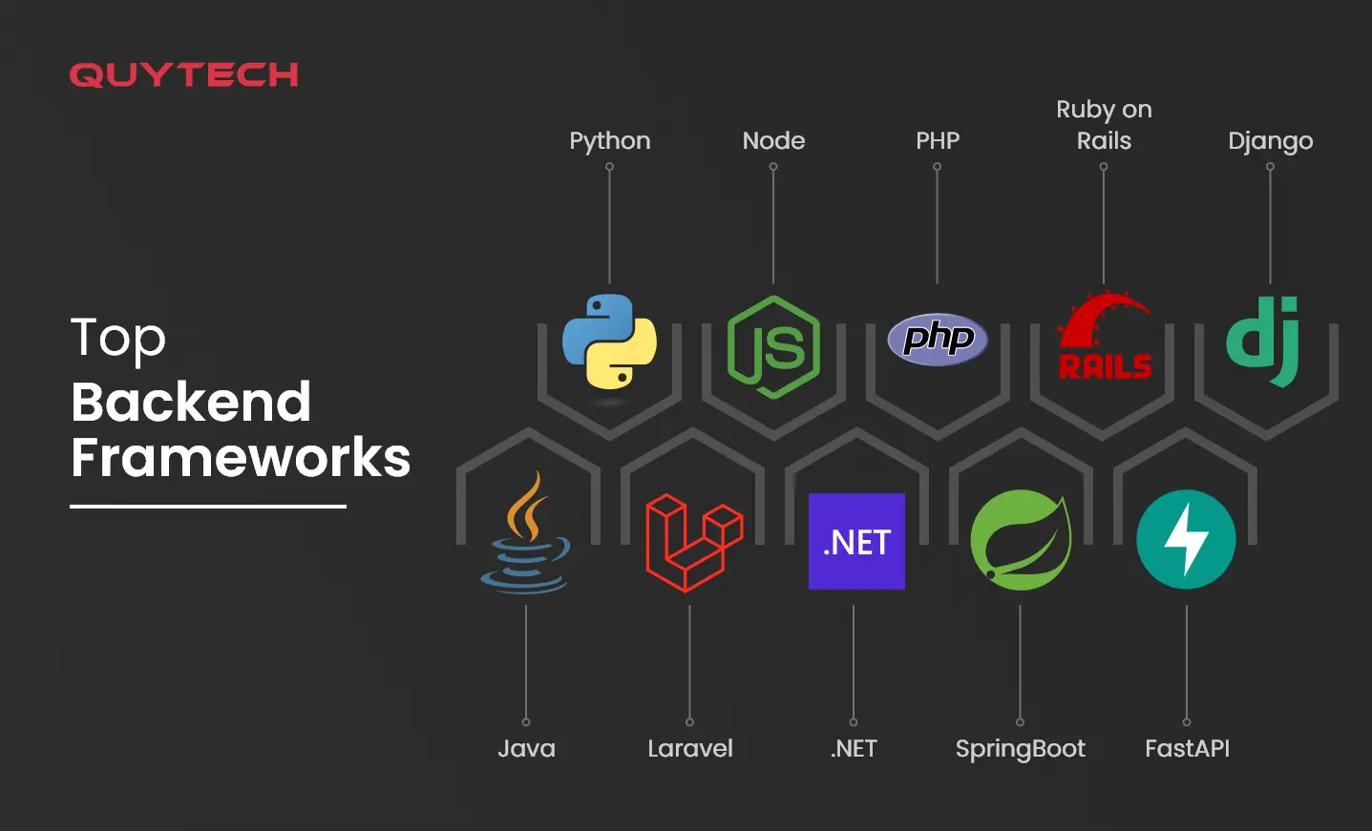
4. Modern Web (2015 - Now)
Frontend frameworks (React, Angular, Vue)
Backend evolution (Node.js, Django, Flask)

Slide 12
Front-End vs Back-End vs Full-Stack

Slide 13
Front-End Development (Client-Side)
Front-end development refers to everything the user sees and interacts with in a web application. It's the "client-side" part of the web — meaning it runs in your browser.
Designing User Interfaces (UI)
Building Interactive Features
Responsive Design
Performance Optimization
Accessibility
Category | Examples
Markup | HTML
Styling | CSS, SASS, Bootstrap, Tailwind CSS
Scripting | JavaScript, TypeScript
Libraries | React.js, jQuery
Frameworks | Angular, Vue.js
Tools | Webpack, Babel, npm/yarn

Slide 14


Slide 15
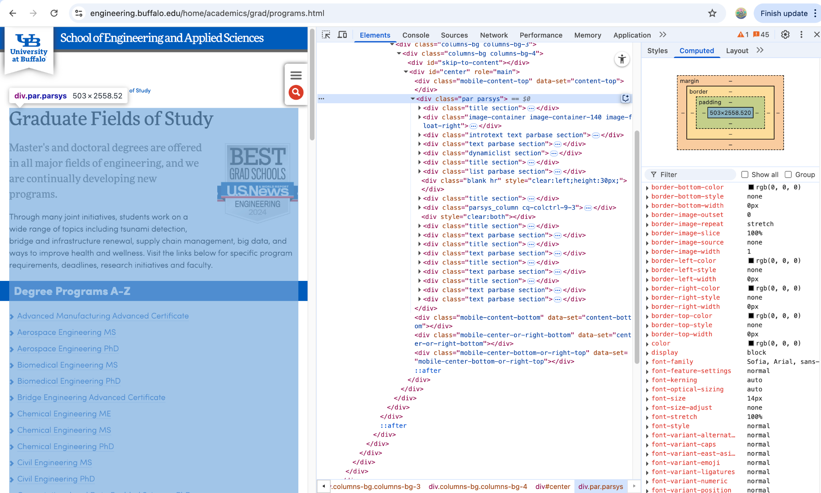

Slide 16
Back-End Development (Server-Side)
Back-end development refers to the server-side logic that powers the front-end. It deals with databases, APIs, authentication, and business logic. It’s invisible to users but essential for functionality.
Key Responsibilities:
Creating APIs
Managing Databases
User Authentication & Authorization
Server Configuration & Security
Handling Requests
Category | Examples
Languages | Python, JavaScript (Node.js), Java, PHP, Ruby
Frameworks | Express.js, Django, Flask, Spring Boot, Laravel
Databases | MySQL, PostgreSQL, MongoDB, Redis
Servers | Apache, Nginx
APIs | RESTful APIs, GraphQL
Security | JWT, OAuth, SSL/TLS

Slide 17
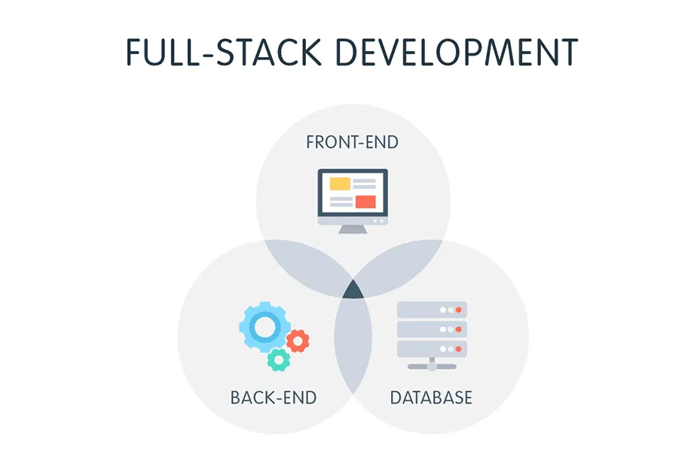
Full-Stack Development
Full-stack developers are skilled in both front-end and back-end. They can build complete web applications from designing UI to writing business logic and handling databases.

Slide 18
3. Full-Stack Development
Stack | Components
MERN | MongoDB, Express.js, React.js, Node.js
MEAN | MongoDB, Express.js, Angular, Node.js
LAMP | Linux, Apache, MySQL, PHP
Django + React | Django (back-end), React.js (front-end)
Why are Full-Stack Developers Valuable?
They understand the entire architecture of a web app.
Great for startups or small teams where roles are flexible.
Help bridge the gap between front-end and back-end teams.

Slide 19
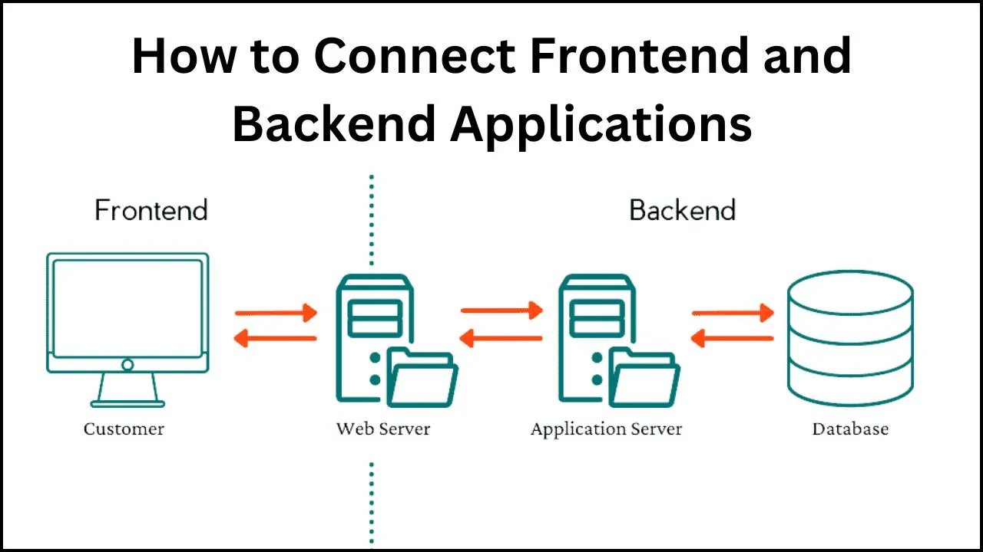

Slide 20
Let’s Build Portfolio Website
Make sure you follow along as we build each piece of the portfolio.
Believe us, It will be super fun!! :)

Slide 21
HTML Fundamentals

Slide 22
What is HTML
Stands for Hypertext Markup Language
Describes the structure of a Web page
It consists of a series of elements
These elements tell the browser how to display the content
<!DOCTYPE html>
<html>
<head>
<title>My First Webpage</title>
</head>
<body>
<h1>Hello, World!</h1>
</body>
</html>

Slide 23
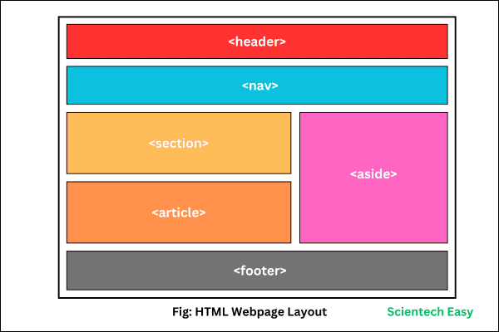
HTML Web Page Layout

Slide 24
HTML Web Page Layout
HTML5 introduces semantic elements that help structure a webpage clearly and meaningfully. Here's a breakdown of the layout shown in the diagram:
1. <header> - Top section of a webpage. Commonly used for branding, logo, and introductory content.
2. <nav> - Defines the navigation links. Helps users browse through the site easily.
3. <section> - Groups related content together by theme. Think of it like chapters in a book.
4. <article> - Holds self-contained, reusable content like blog posts or news items. Can exist independently.
5. <aside> - Provides additional info or side content, like ads, links, or related articles.
6. <footer> - Appears at the bottom of the page. Contains copyright info, contact links, and site details.

Slide 25
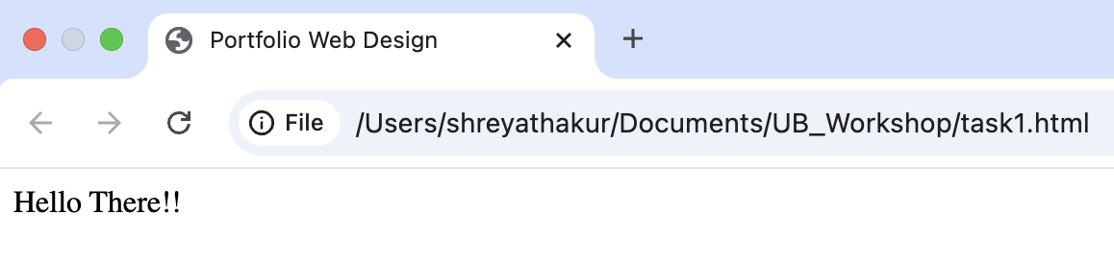
Task 1
<!DOCTYPE html>
<html lang="en">
<head>
<meta charset="UTF-8">
<meta name="viewport" content="width=device-width, initial-scale=1.0">
<title>Portfolio Web Design</title>
<link rel="preconnect" href="https://fonts.googleapis.com">
<link rel="icon" type="image/jpg" href="./imgs/favicon.jpg">
</head>
<body>
Hello There!!
</body>
</html>

Slide 26
What is an Element
HTML elements are the building blocks of web pages.
It is defined by a start tag, some content, and an end tag
The start tag - name, and the end tag - forward slash (/) + name.
Example1: Paragraph Tag Example2: Image Tag
<tagname> Content goes here... </tagname>
<p>My first paragraph.</p>
<img src="./imgs/favicon.jpg" alt="UB Logo">

Slide 27
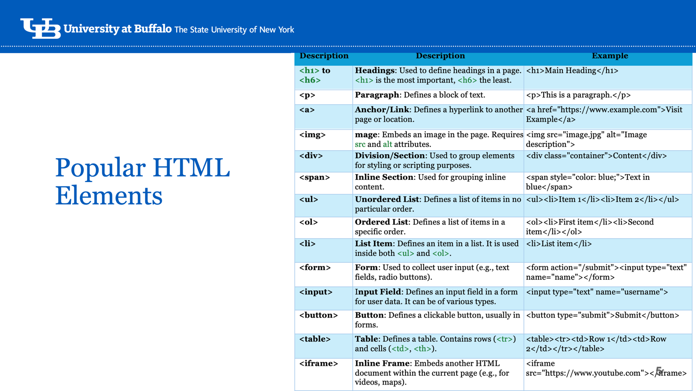
Popular HTML Components

Slide 29
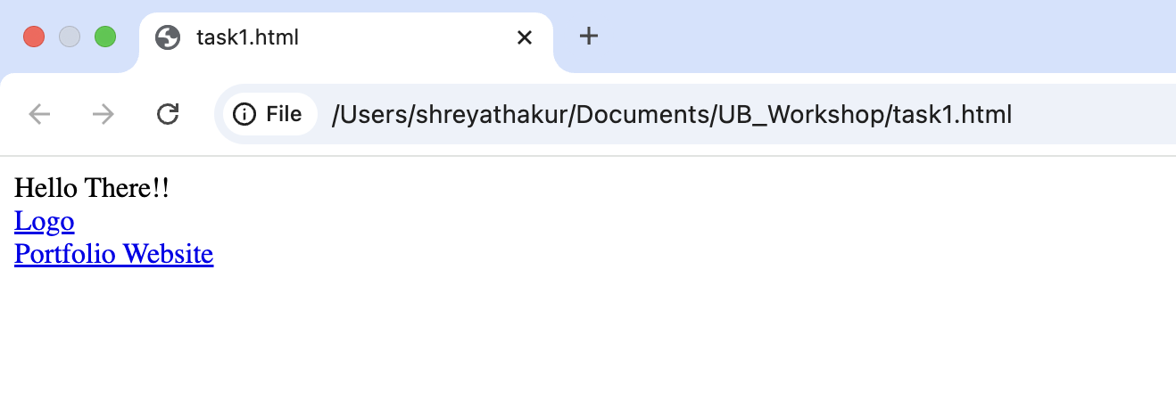
Task 2
<body>
Hello There!!
<header>
<a href="#" class="logo-holder">
<div class="logo">Logo</div>
<div class="logo-text">Portfolio Website</div>
</a>
</header>
</body>

Slide 30
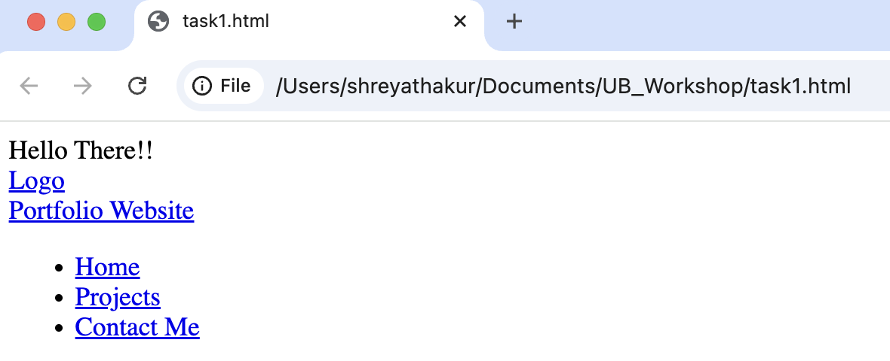
Taks 3
<nav>
<ul id="menu">
<li>
<a href="#">Home</a>
</li>
<li>
<a href="#projects">Projects</a>
</li>
<li>
<a href="mailto:hello@adriantwarog.com" class="button">Contact Me</a>
</li>
</ul>
</nav></header>

Slide 31
Task 4
<main>
<section class="hero container">
<div class="hero-blue">
<div>
<h1><small>Hi I'm</small>
Shreya Thakur
</h1>
<p>
Master's Student at UB. <span>I'm specializing in AI and Machine Learning. I'm passionate about applying innovative technologies to solve real-world problems and eager to contribute to advancements in AI and data science.</span>
</p>
</div>
</div>
</section>
</main>

Slide 32
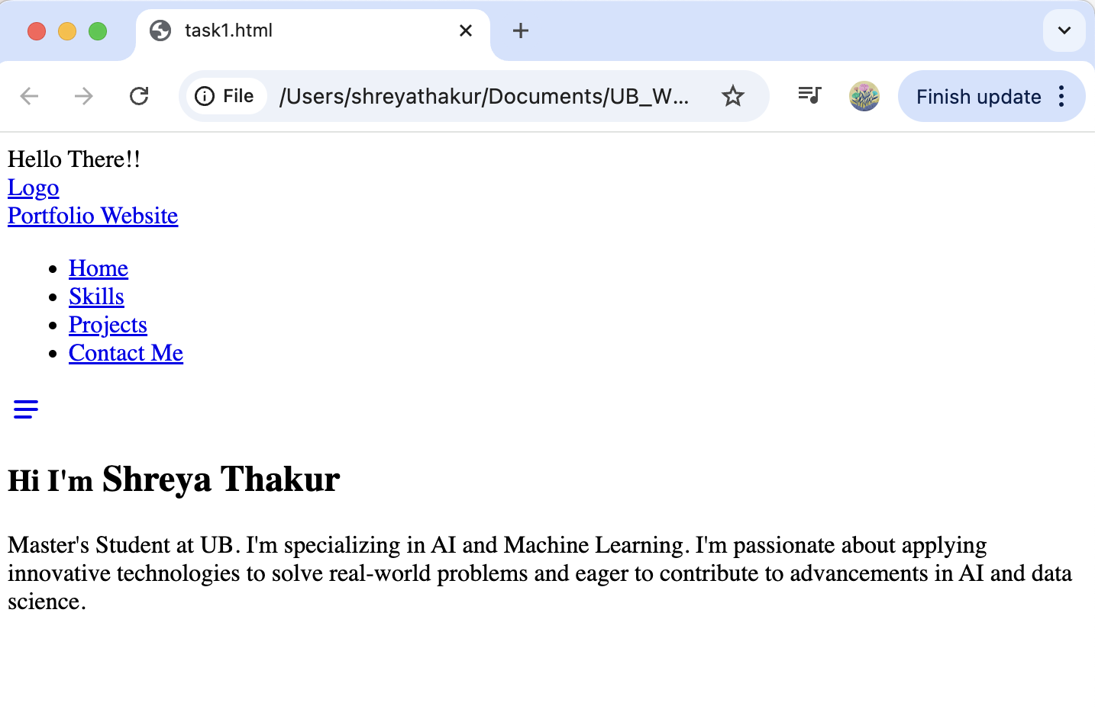
Task 4

Slide 33
Task 5
</p>
<div>
<a href="./Sample_Resume_Template.pdf" class="button black">
View Resume
</a>
</div>
<div class="social-links">
<a href="#">
<img src="./imgs/github.png" alt="GitHub" width="48" />
</a>
<a href="#">
<img src="./imgs/linkedin.png" alt="LinkedIn" width="48" />
</a>
</div></div></div></section>

Slide 34
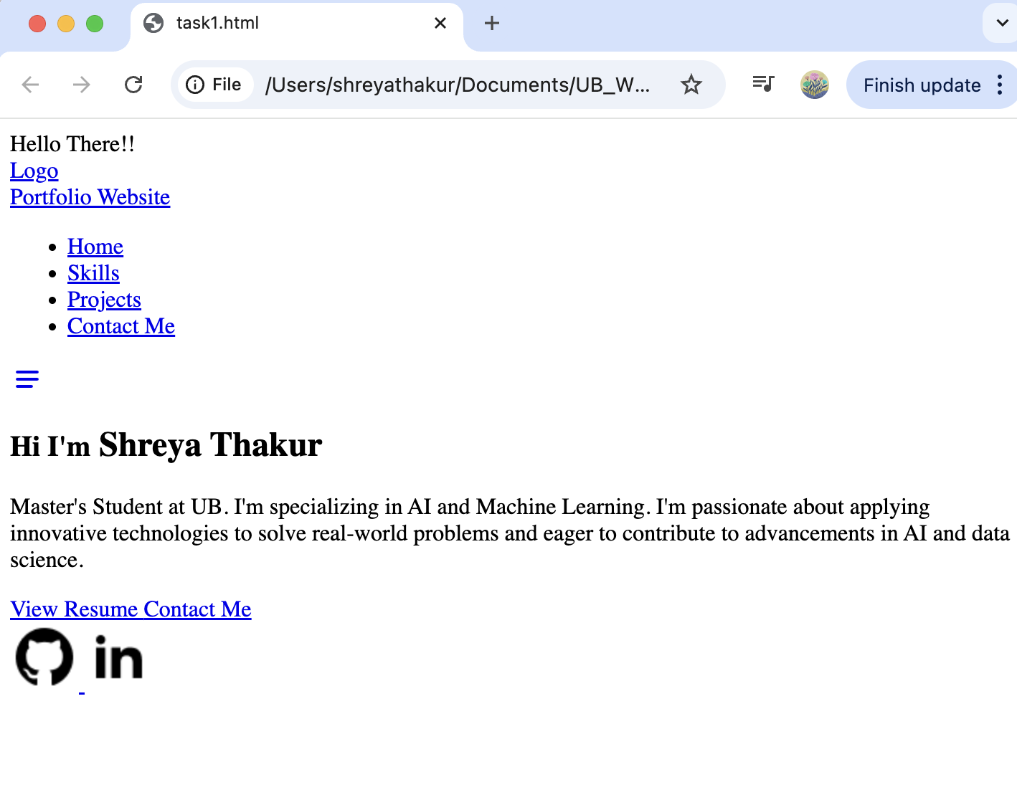
Task 5

Slide 35
Task 6
<section class="work-experience container">
<h2>
<small>Recent</small>
Work Experience
</h2>
<div class="jobs">
<article>
<figure>
<div>
<img src="./imgs/workplace-1.jpg" alt="Workplace-1 - YouTube Creator" width="100%" />
<figcaption>
Workplace - 1 YouTube Creator
</figcaption>
</div>
</figure>
<h3>YouTube Content Creator</h3>
<div>2025-current</div>
<p>Content creation online teaching people about how to code using HTML, CSS, JS.</p>
</article>
<div>
</section>

Slide 36


Slide 37
Bootstrap

Slide 38
What is Bootstrap
Bootstrap is a widely used open-source front-end framework that streamlines web development by providing pre-designed, responsive UI components and a flexible grid system. It enables developers to quickly create mobile-first, consistent, and customizable websites with minimal effort.

Slide 39
Why use Bootstrap?
Open-source framework: Simplifies web development with pre-built tools and components.
Responsive design: Uses a flexible grid system to create mobile-first, adaptive layouts.
Pre-designed UI components: Includes buttons, forms, navigation bars, modals, and more for quick integration.
Cross-browser compatibility: Ensures consistent styles and behavior across various browsers.
Built with HTML, CSS, and JavaScript: Leverages these core web technologies for structure and functionality.
Customizable: Allows easy customization to fit project-specific needs.
Efficient development: Speeds up the process of building professional, modern websites.

Slide 40
Pre-Styled Components
With HTML: With CSS:
Bootstrap: Bootstrap's classes already provide a consistent design without the need for custom CSS!!
<button>Save it</button>
button {
background-color: #007bff;
color: white;
padding: 10px 20px;
border: none;
border-radius: 5px;
}
<button class="btn btn-primary">Click Me</button>

Slide 41
<head>
<meta charset="UTF-8">
<title>Bootstrap Card Example</title>
<link href="https://cdn.jsdelivr.net/npm/bootstrap@5.3.3/dist/css/bootstrap.min.css" rel="stylesheet">
</head>
<body>
<div class="container mt-5">
<div class="card" style="width: 18rem;">
<img src="imgs/bootstrap_test.png" class="card-img-top" alt="...">
<div class="card-body">
<h5 class="card-title">Card Title</h5>
<p class="card-text">This is a simple card with some text and a button.</p>
<a href="#" class="btn btn-primary">Go somewhere</a>
</div>
</div>
</div>
</body>

Slide 42
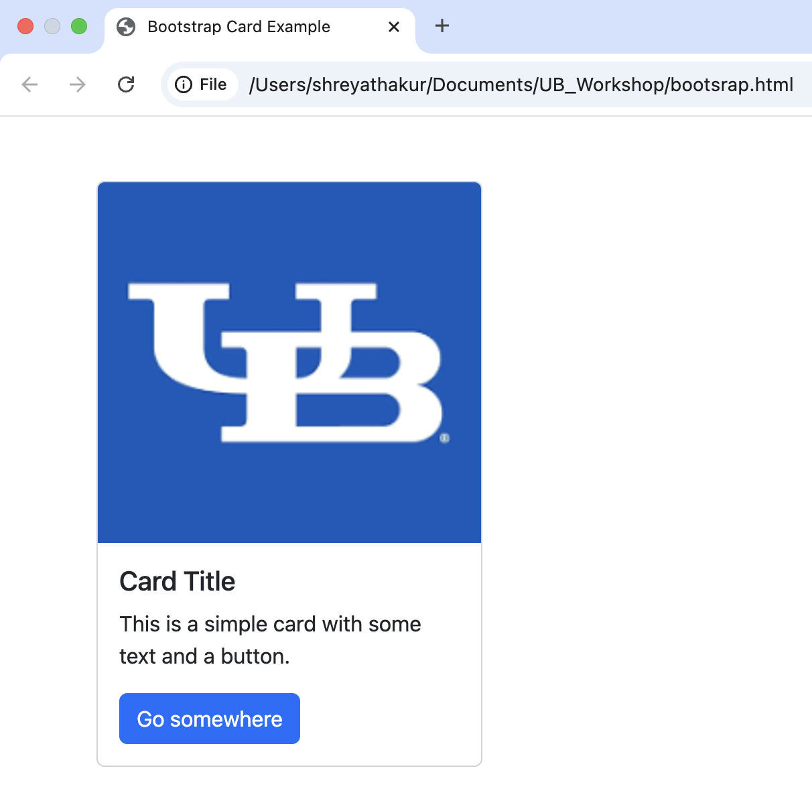

Slide 43
CSS
Where beauty lies!

Slide 44
CSS
CSS is used to style and visually enhance HTML elements on a webpage.
It allows you to define the layout, colors, fonts, and overall design of a site, making it look appealing and user-friendly.
CSS helps separate structure from style, providing flexibility in design and ensuring consistency across webpages.

Slide 45
CSS Selectors
Selector Example Example description
#id #firstname Selects the element with id="firstname"
.class .intro Selects all elements with class="intro"
* * Selects all elements
element p Selects all <p> elements
element,element,.. div, p Selects all <div> elements and all <p> elements

Slide 46
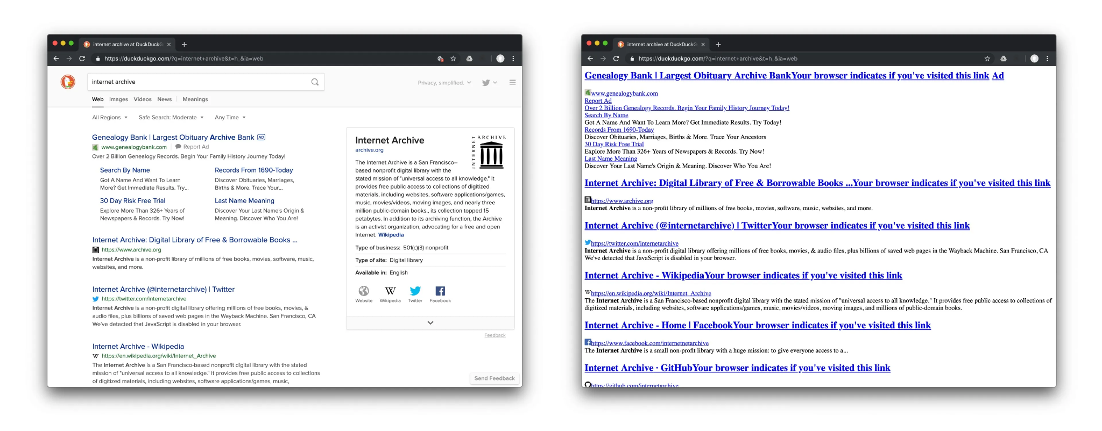
CSS

Slide 47
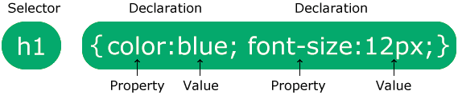
CSS Selectors

Slide 48
CSS Insertion
There are three ways of inserting a style sheet:
External CSS
Internal CSS
Inline CSS
<style>
body {
background-color: linen;
}
h1 {
color: maroon;
margin-left: 40px;
}
</style>
<link rel="stylesheet" href="mystyle.css">
<p style="color:red;">This is a paragraph.</p>

Slide 49
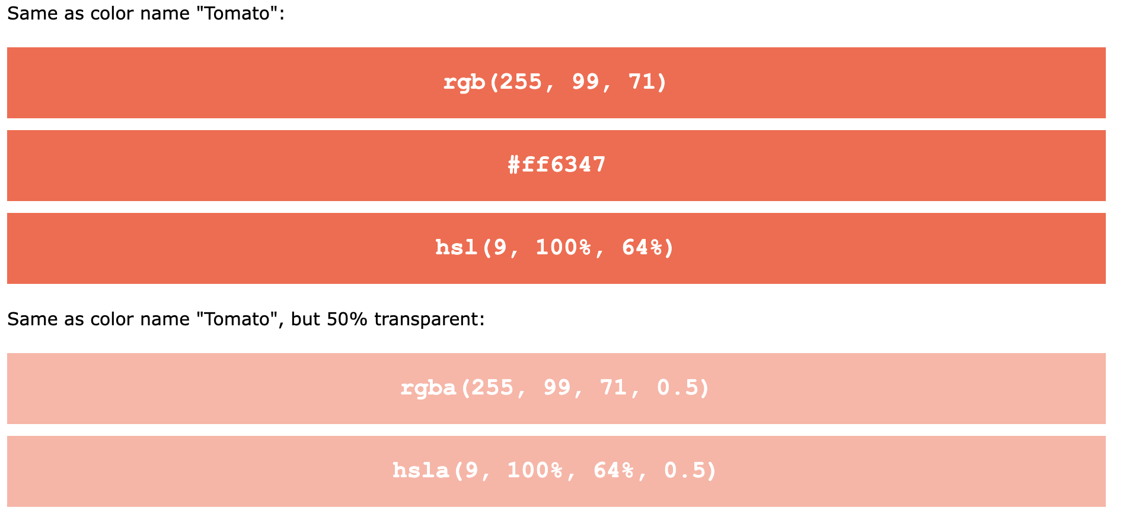
CSS Colors
Customize your own color - https://www.w3schools.com/css/css_colors_rgb.asp

Slide 50
CSS Colors
<h1 style="background-color:rgb(255, 99, 71);">...</h1>
<h1 style="background-color:#ff6347;">...</h1>
<h1 style="background-color:hsl(9, 100%, 64%);">...</h1>
<h1 style="background-color:rgba(255, 99, 71, 0.5);">...</h1>
<h1 style="background-color:hsla(9, 100%, 64%, 0.5);">...</h1>

Slide 51
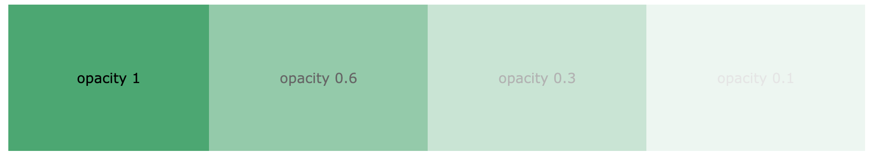
CSS Colors
div {
background-color: green;
opacity: 0.3;
}
div {
background: rgba(0, 128, 0, 0.3)
}

Slide 52
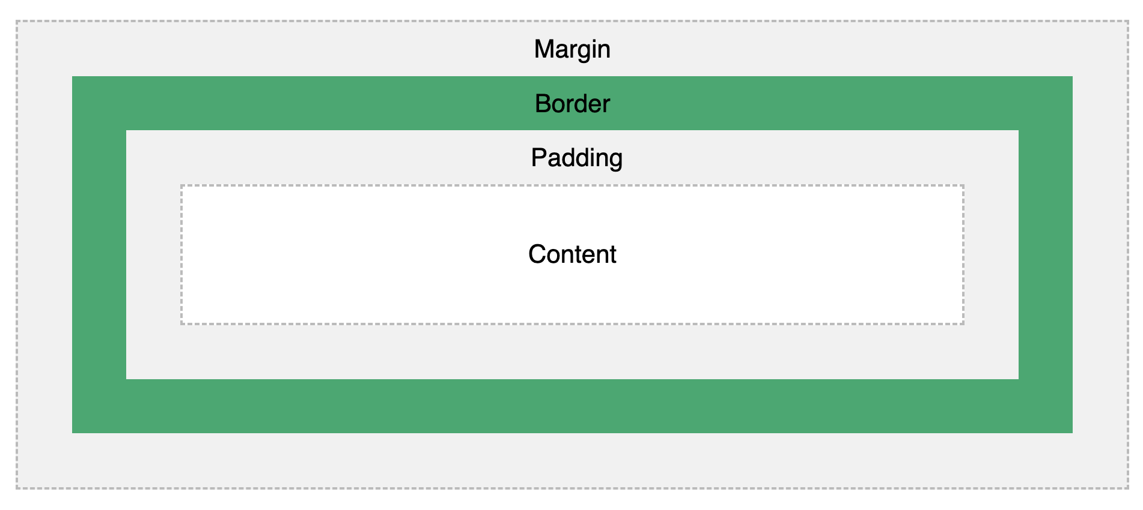
CSS Box Model

Slide 53
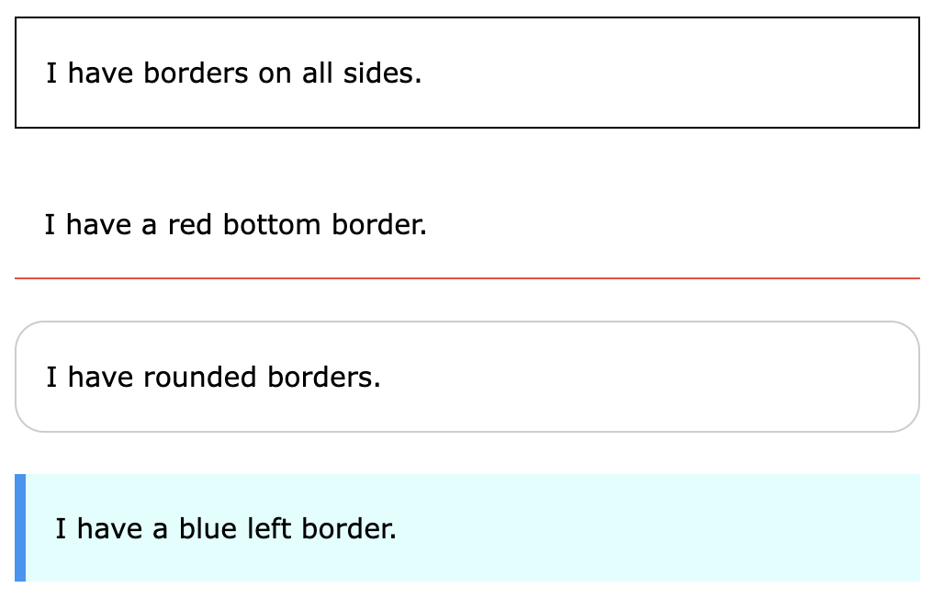
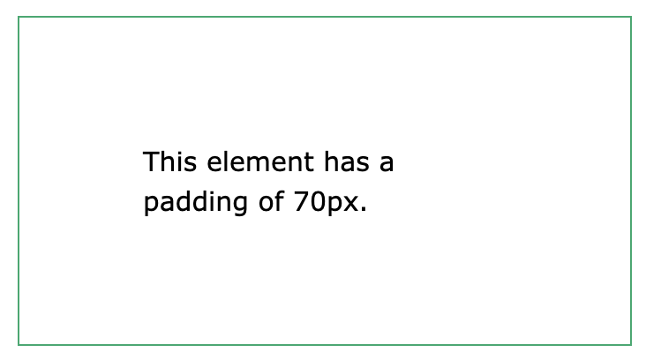
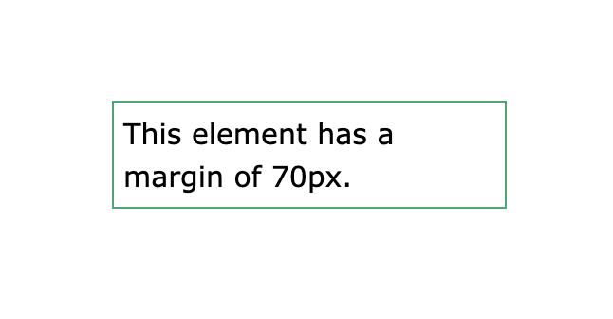
CSS Borders, Margin, Padding
border-width
border-color
border-style
border-radius
margin
margin-left
margin-right
margin-bottom
margin-top
padding-top
padding-right
padding-bottom
padding-left

Slide 54

CSS Text Formatting
Task 1
h1 {
color: red;
text-decoration: underline red double 5px;
text-transform: capitalize; text-shadow: 2px 2px;
}

Slide 55
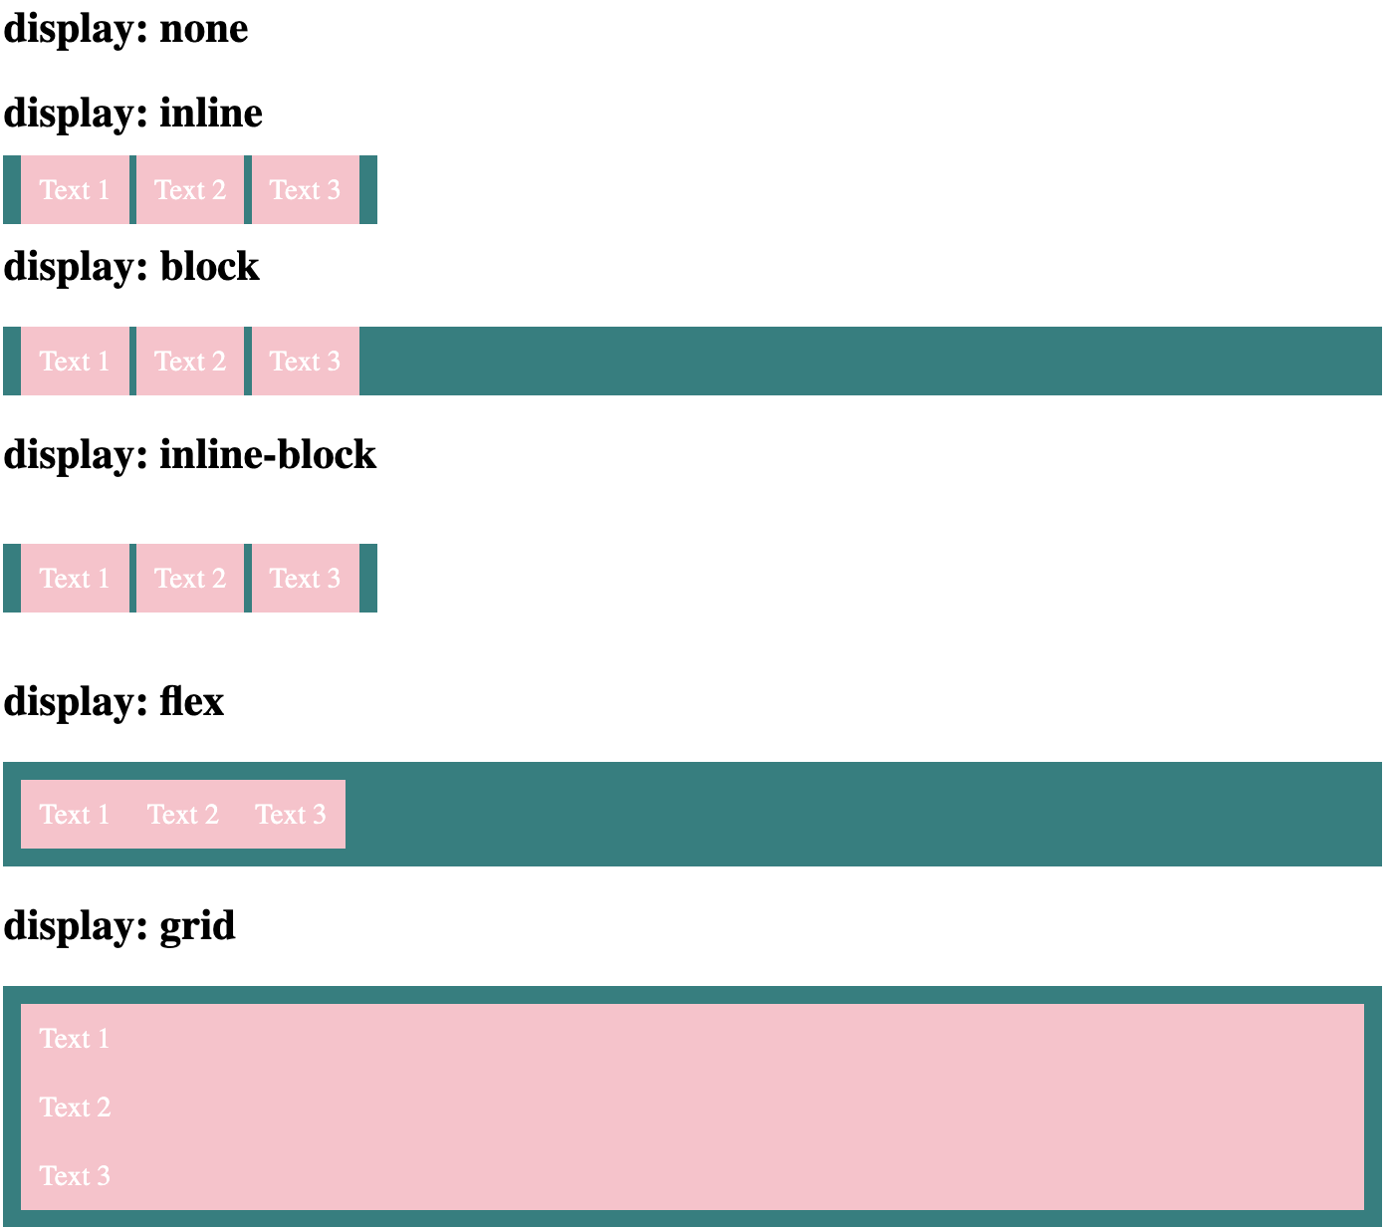
CSS Display
<h2>display: inline-block</h2>
<p class="test_display">
<span>Text 1</span>
<span>Text 2</span>
<span>Text 3</span>
</p>

Slide 56
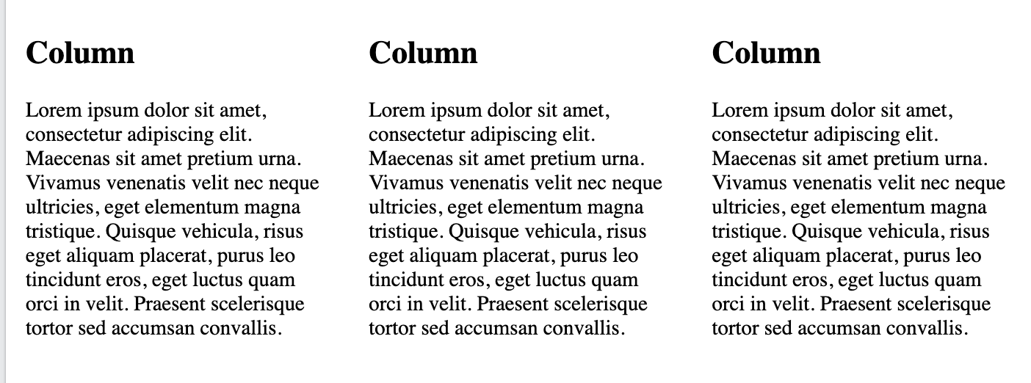
CSS Layouts
Responsive layout : It makes the three columns stack on top of each other instead of next to each other on smaller screens (600px wide or less)
@media screen and (max-width: 600px) {
.column {
width: 100%;
}
}

Slide 57
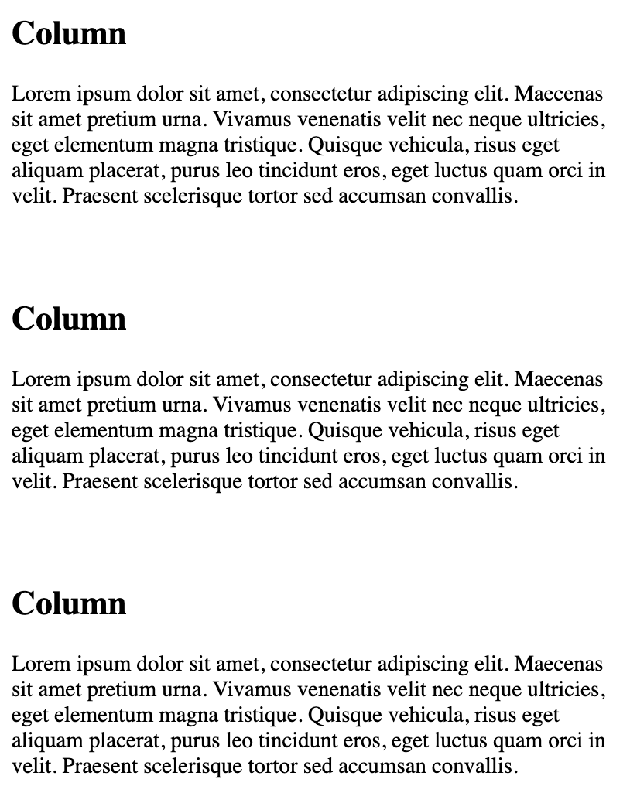
CSS Layouts
Responsive layout : It makes the three columns stack on top of each other instead of next to each other on smaller screens (600px wide or less)

Slide 58

CSS Icons, Lists
<i class="fas fa-cloud"></i>
<i class="fas fa-heart"></i>
<i class="fas fa-car"></i>
<i class="fas fa-file"></i>
<i class="fas fa-bars"></i>

Slide 59
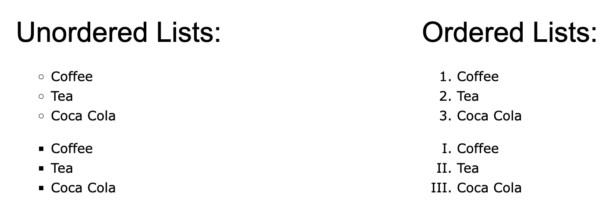
CSS Lists
Task 2
ul.a {
list-style-type: circle;
}
ul.b {
list-style-type: square;
}
ol.c {
list-style-type: upper-roman;
}
ol.d {
list-style-type: lower-alpha;
}

Slide 60
JAVASCRIPT
Where magic happens!

Slide 61
Javascript
JavaScript is a programming language that adds interactivity to web pages.
While HTML defines the structure and CSS controls the look, JS enables dynamic behavior and allows the web page to respond to user actions.
JavaScript makes websites interactive, enabling features like forms, animations, and live content updates.

Slide 62
Javascript can change HTMl & CSS content
document.getElementById(‘demo’).innerHTML = ‘Hello JavaScript’;
document.getElementById("demo").style.fontSize = "35px";
document.getElementById("demo").style.display = "none";

Slide 63
Javascript can change HTMl content
Task 1
<button onclick="document.getElementById('myImage').src='pic_bulbon.gif'">
ON
</button>
<img id="myImage" src="pic_bulboff.gif" style="width:100px">
<button onclick="document.getElementById('myImage').src='pic_bulboff.gif'">
OFF
</button>

Slide 64
Javascript <script> Tag
<script> document.getElementById("demo").innerHTML = "My First JavaScript"; </script>
<script>
function myFunction() {
document.getElementById("demo").innerHTML = "Paragraph changed.";
}
</script>
<script src="script.js"></script>

Slide 65
Javascript Output - Task 2
<script> console.log(5+6) </script>
<script> <button type="button" onclick="document.write(5 + 6)">Try it</button> </script>
<button onclick="window.print()">Print this page</button>

Slide 66
Javascript syntax
Keyword Description
var Declares a variable
let Declares a block variable
const Declares a block constant
if Marks a block of statements to be executed on a condition
switch Marks a block of statements to be executed in different cases
for Marks a block of statements to be executed in a loop
function Declares a function
return Exits a function

Slide 67
Javascript syntax
Task 3
What is the result?
let x = 5;
let y = '8';
let z = x + y;
let text1 = "What a very ";
text1 += "nice day";
let x = 5 + 5;
let y = "5" + 5;
let z = "Hello" + 5;

Slide 68
Javascript syntax
Operator Example Same As
= x = y x = y
+= x += y x = x + y
-= x -= y x = x - y
*= x *= y x = x * y
/= x /= y x = x / y
%= x %= y x = x % y
**= x **= y x = x ** y

Slide 69
Javascript Datatypes
Numbers:
let length = 16;
let weight = 7.5;
Strings:
let color = "Yellow";
let lastName = "Johnson";
Booleans:
let x = true;
let y = false;
Object: const person = {
firstName: "John",
lastName: "Doe"
};
Array object:
const cars = ["Saab", "Volvo", "BMW"];
Date object:
const date = new Date("2022-03-25");

Slide 70
Javascript Datatypes
Task
Lets print these values and test
let x; // x is undefined
x = 5; // x is a Number
x = "John"; // x is a String

Slide 71
Javascript Functions and Objects
let x = myFunction(4, 3);
function myFunction(a, b) {
// Function returns the product of a and b
return a * b;
}
console.log(x)
objectName.propertyName
objectName["propertyName"]
objectName.methodName()

Slide 72
Javascript Objects - Task 4
Lets print person full name and test
const person = {
firstName: "John",
lastName: "Doe",
id : 5566,
fullName : function() {
return this.firstName + " " + this.lastName;
}
};

Slide 73
Javascript Objects
const myArray = Object.values(person);
const myString = JSON.stringify(person);
Task 5
What is the result?
const person = {
name: "John",
age: 30,
city: "New York"
};
document.getElementById("demo")
.innerHTML = person;
const fruits = {Bananas:300, Oranges:200, Apples:500};
let text = "";
for (let [fruit, value] of Object.entries(fruits)) {
text += fruit + ": " + value + "<br>";
}

Slide 74
Javascript String Objects - Task 6
Try this!!
let x = "John"; let x = "John";
let y = new String("John"); let y = new String("John");
console.log(x==y) console.log(x===y)

Slide 75
Javascript Events
An HTML web page has finished loading
An HTML input field was changed
An HTML button was clicked
<button onclick="document.getElementById('demo').innerHTML = Date()">
The time is ?
</button>

Slide 76
Javascript Events
Event Description
onchange An HTML element has been changed
onclick The user clicks an HTML element
onmouseover The user moves the mouse over an HTML element
onmouseout The user moves the mouse away from an HTML element
onkeydown The user pushes a keyboard key
onload The browser has finished loading the page

Slide 77
Mouse Events
<div onmouseover="mOver(this)" onmouseout="mOut(this)" >
Mouse Over Me
</div>
<script>
function mOver(obj) {
obj.innerHTML = "Thank You"
}
function mOut(obj) {
obj.innerHTML = "Mouse Over Me"
}
</script>

Slide 78
Add Events Handler - Task 7
element.addEventListener("click", myFunction);
function myFunction() {
alert ("Hello World!");
}
element.removeEventListener("click", myFunction);

Slide 79

DOM Navigation
You can use the following node properties to navigate between nodes with JavaScript:
parentNode
childNodes[nodenumber]
firstChild
lastChild
nextSibling
previousSibling
myTitle = document.getElementById("demo").firstChild.nodeValue;
myTitle = document.getElementById("demo").childNodes[0].nodeValue;

Slide 80
Portfolio Development
Tasks
Wrapping up the Portfolio
A fun quiz

Slide 81
References
https://www.w3schools.com
https://developer.mozilla.org/en-US/docs/Learn_web_development
https://getbootstrap.com/docs/5.3/getting-started/introduction/
https://developer.mozilla.org/en-US/docs/Learn_web_development/Core/Structuring_content
https://www.youtube.com/watch?v=O3m-OMfYgW8&t=167s
https://github.com/adriantwarog/portfolio-getting-started-assets

Slide 82
Thank You

